Slide 1

WEEK 4 Transistor Model - MOSFET
Engineering
Electrical Engineering & Telecommunications
Dr. Aron Michael 2023

Slide 2
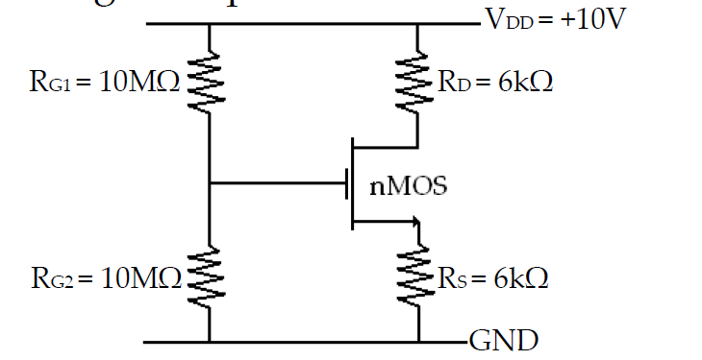
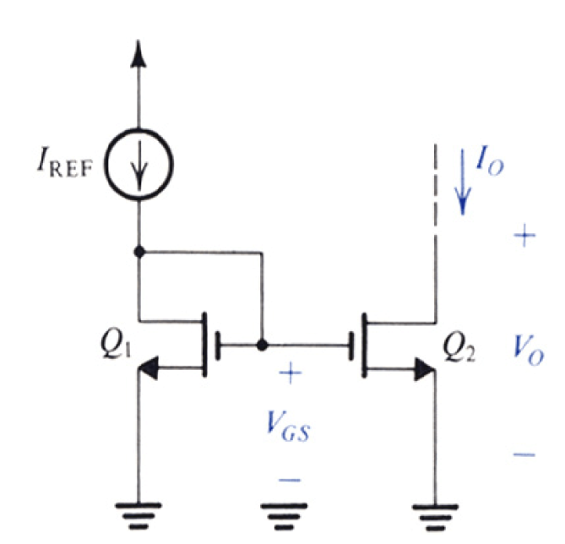
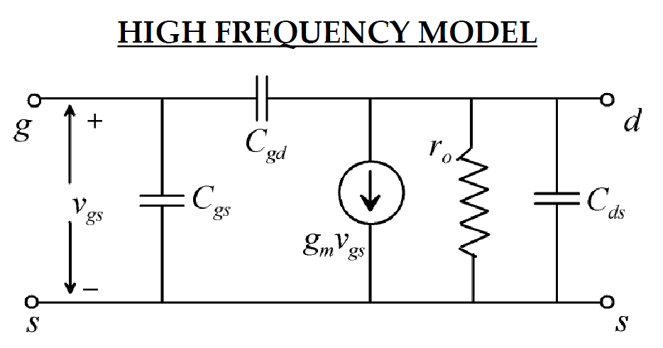




Slide 3
Learning Outcomes
At the end of this week, you will be able to
Draw the small signal circuit model of MOSFET.
Calculate the small signal circuit model parameters of MOSFET.
Draw the small signal equivalent circuit of MOSFET based amplifiers.
Analyze the performance of the amplifiers such as gain, bandwidth, input impedance and output impedance.
Draw the DC equivalent circuit of MOSFET based amplifiers and calculate the quiescent values (I_{DQ}, I_{SQ}, V_{DSQ} ).
Explain DC biasing configurations such as current mirrors.

Slide 4
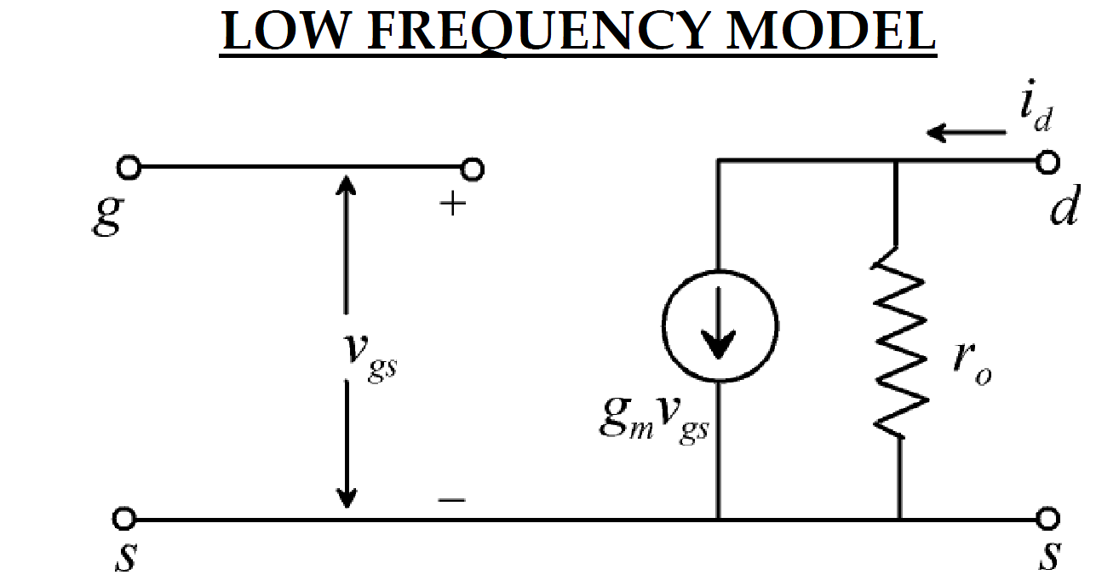

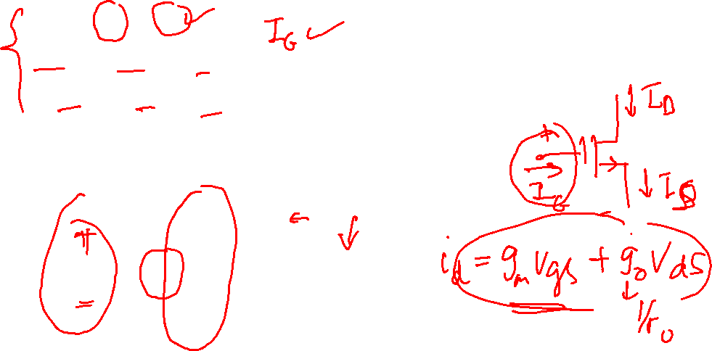


Transistor Circuit Model - MOSFET
Linearization and graphical analysis
Concerned with small signal variations about the operating points.
Interested in a relationship between i_{d}, v_{gs} and v_{ds}
$i_{D}=$ $I_{D}+i_{d}$
$v_{DS}=$ $V_{DS}+v_{ds}$
$v_{GS}=$ $V_{GS}+v_{gs}$

Slide 5
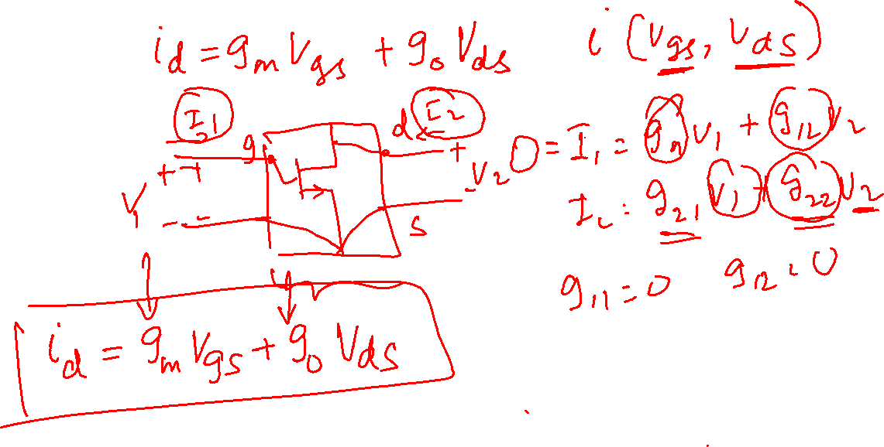
Transistor Circuit Model - MOSFET

Slide 6
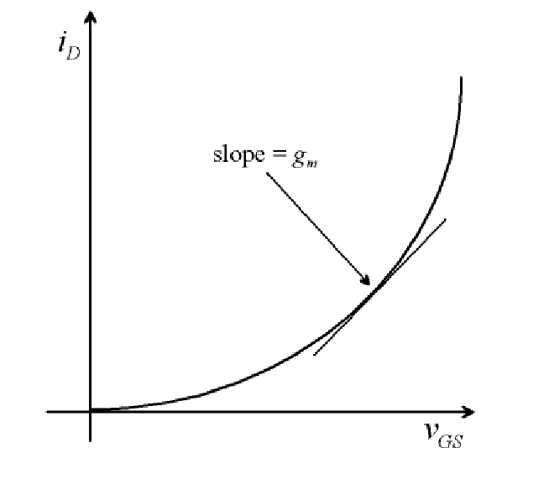
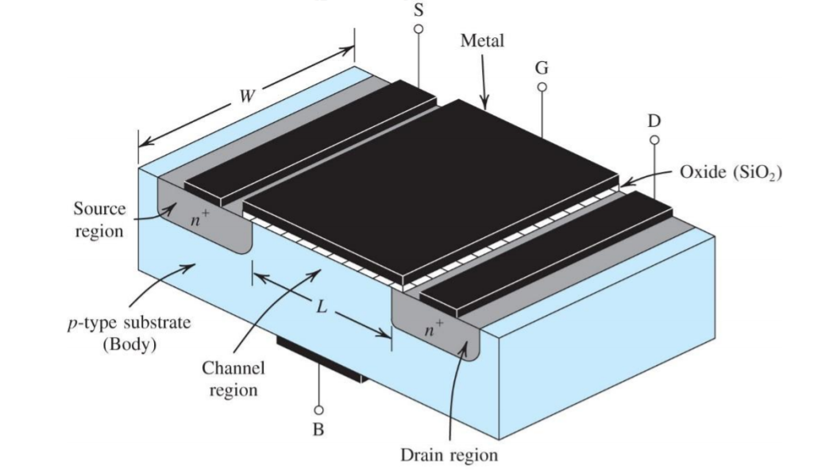
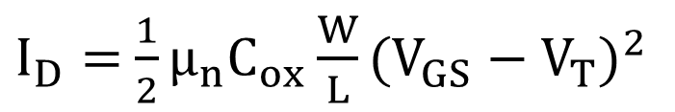
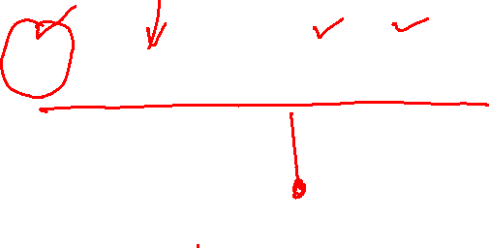
Transistor Circuit Model - MOSFET
Linearization and graphical analysis
The voltage‐controlled current source g_{m}v_{gs} relates i_{d} to v_{gs} for the MOSFET operating in the saturation region. g_{m} is given by the slope of the transfer characteristic at the operating point
$I_{D}=$ ${\frac{1}{2}μ}_{n}C_{ox}{\frac{W}{L}(V_{GS}−V_{T})}^{2}$

Slide 7


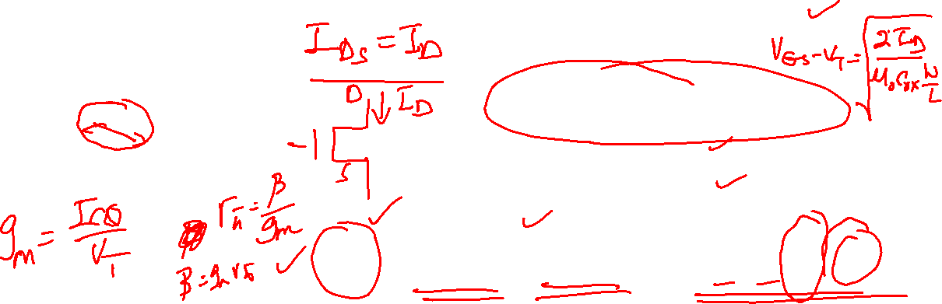
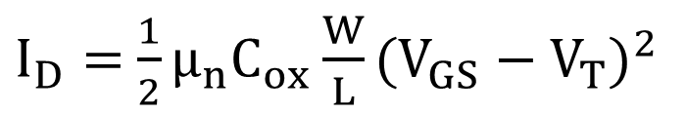
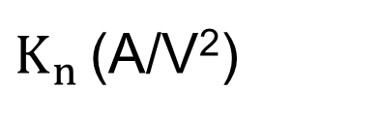

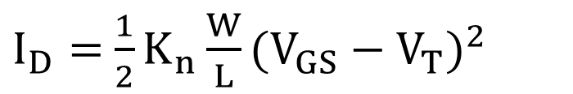
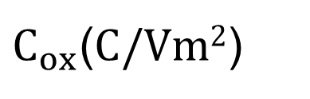
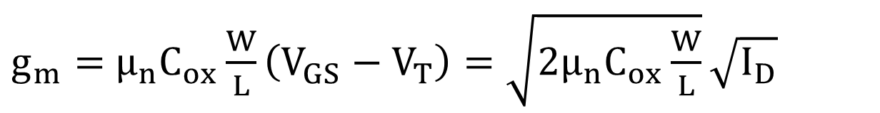
Transistor Circuit Model - MOSFET
Calculation of g_{m} and r_{o}
$I_{D}=$ ${\frac{1}{2}μ}_{n}C_{ox}{\frac{W}{L}(V_{GS}−V_{T})}^{2}$
$K_{n}=$ $μ_{n}C_{ox}$
$I_{D}=$ ${\frac{1}{2}K}_{n}{\frac{W}{L}(V_{GS}−V_{T})}^{2}$
$$g_{m}=\frac{∂I_{DS}}{∂V_{GS}}$$
$g_{m}=$ $μ_{n}C_{ox}\frac{W}{L}\left(V_{GS}−V_{T}\right)=\sqrt{{2μ}_{n}C_{ox}\frac{W}{L}}\sqrt{I_{D}}$
$K_{n }$(A/V²)
Process transconductance parameter for n-channel MOSFET
$μ_{n}$ (m²/Vs)
Electron mobility
$C_{ox}\text{(}C/Vm2$)
Gate oxide capacitance per unit area

Slide 8



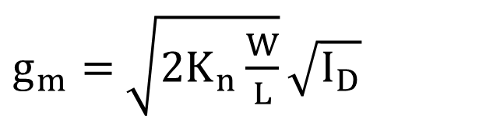
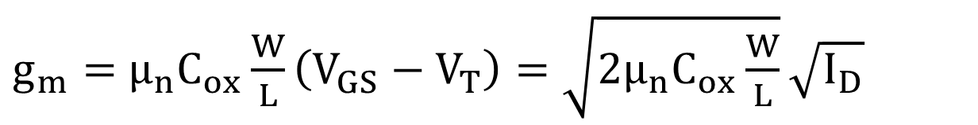


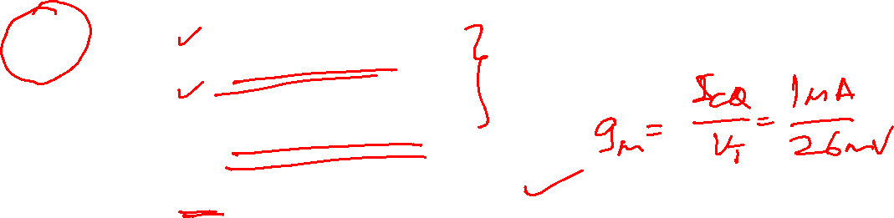




Transistor Circuit Model - MOSFET
$g_{m}=$ $μ_{n}C_{ox}\frac{W}{L}\left(V_{GS}−V_{T}\right)=\sqrt{{2μ}_{n}C_{ox}\frac{W}{L}}\sqrt{I_{D}}$
Note:
g_{m} depends on aspect ratio
g_{m} depends on bias pt.
Typically,
For I_{D}= 1mA, = 1 g_{m} = 0.2mA/V
= 10 g_{m} = 0.632mA/V
Compare to BJT at 1mA, g_{m} = 38.4mA/V
$$\frac{W}{L}$$
$$\sqrt{I_{D}}$$
$g_{m}=$ $\sqrt{{2K}_{n}\frac{W}{L}}\sqrt{I_{D}}$
$$K_{n}=20μA/V2$$
$K_{n}=$ $μ_{n}C_{ox}$
$$\frac{W}{L}$$
$$\frac{W}{L}$$

Slide 9
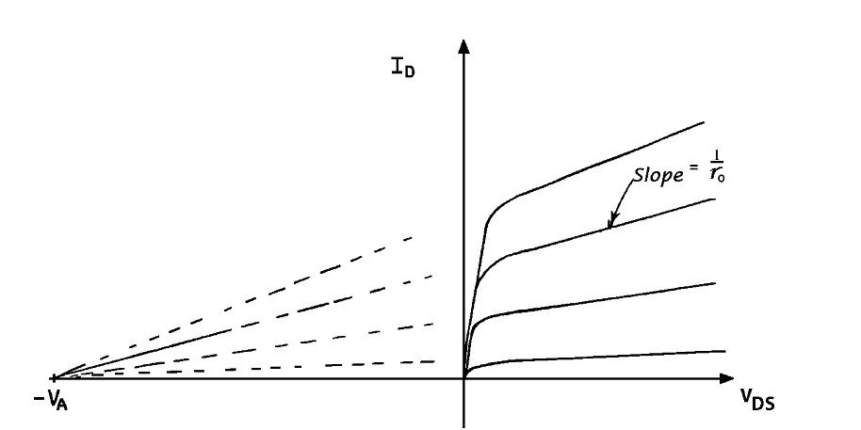

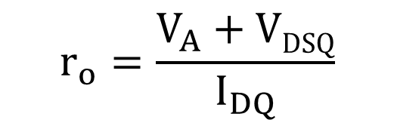
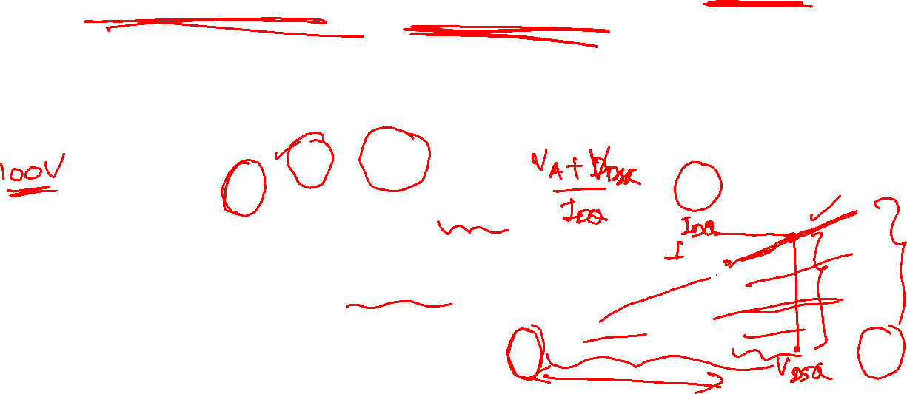
Transistor Circuit Model - MOSFET
In spite of its low g_{m}, MOSFET have other advantages: high Z_{in}, small size, low power dissipation & ease of fabrication.
Note:‐ g_{m} of BJT is geometry independent.
r_{o} ≡ output resistance ⎯ slope of the output characteristic evaluated at the operating point ⎯ due to channel length modulation:
Evaluated at the operating point
typically r_{o} ranges from 10k→100kΩ.
$$r_{o}=\frac{V_{A}+VDSQ}{I_{DQ}}$$
$$≃\frac{V_{A}}{I_{DQ}}$$

Slide 10
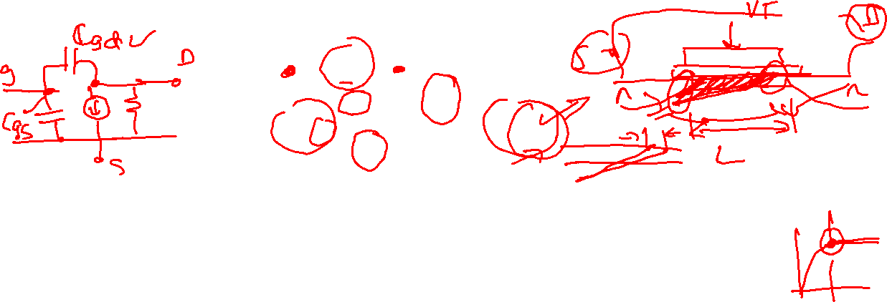
Transistor Circuit Model - MOSFET
The low frequency model can be modified to include intrinsic capacitors and resistors to obtain high frequency model
Range: fraction of pF to 1 or 2 pF, depending on device size.
Note: C_{gd} contributes significantly to the Miller effect, resulting in reduction of gain at high frequencies ⎯ (covered later in the course).
C_{gs} ≡ gate‐source capacitance C_{gd} ≡ gate‐drain capacitance
C_{ds} ≡ drain – substrate capacitance

Slide 11
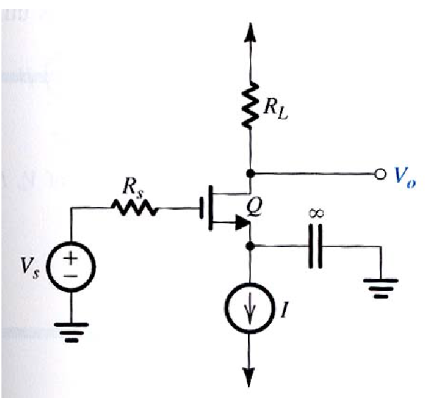
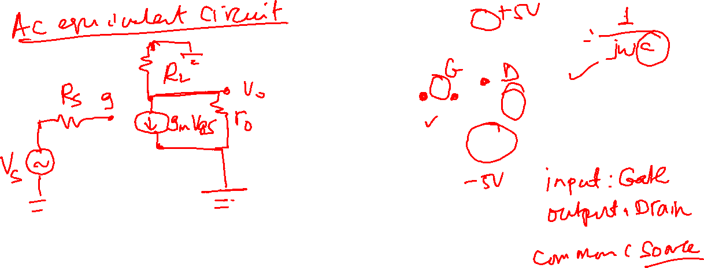
Transistor Circuit Model - MOSFET
Example 1: Common Source Amplifier

Slide 12
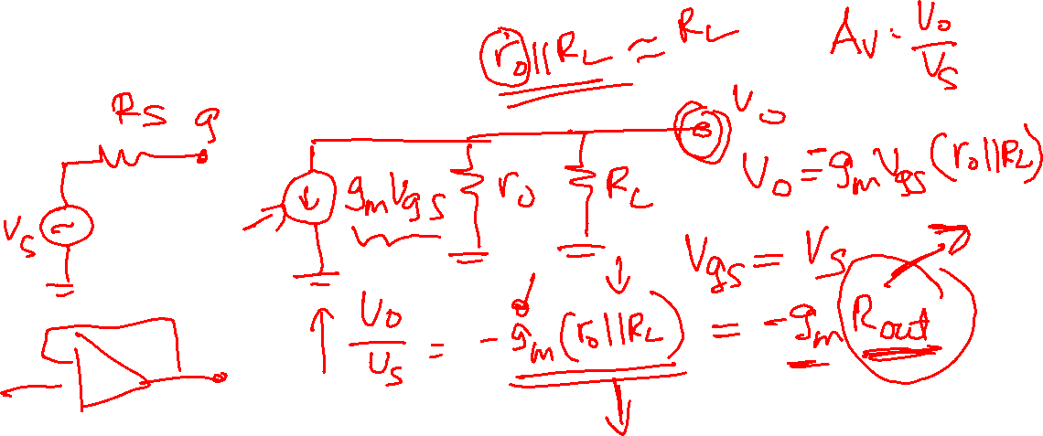
Transistor Circuit Model - MOSFET
Calculate voltage gain ( A_{v} = Vo/Vs)

Slide 13
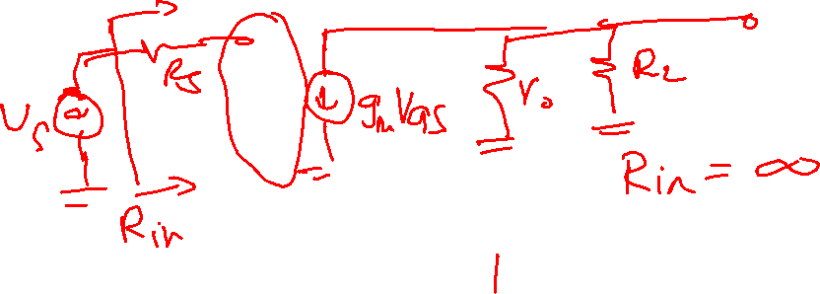
Transistor Circuit Model - MOSFET
Calculate input impedance (R_{in})

Slide 14
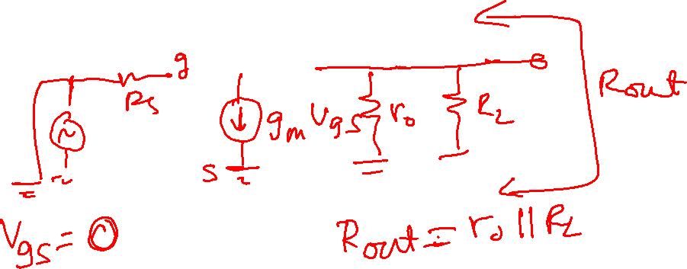
Transistor Circuit Model - MOSFET
Output impedance (R_{out})

Slide 15

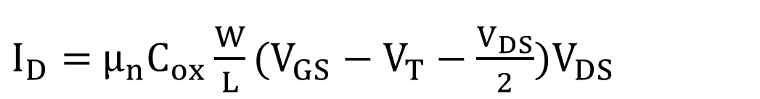
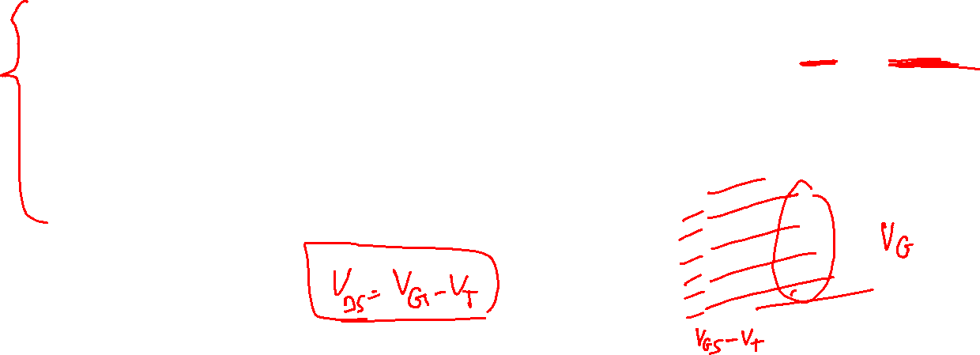
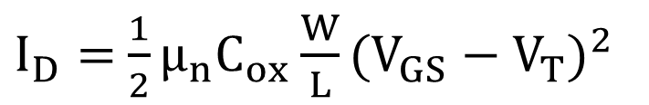
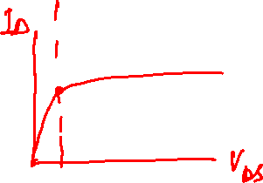
Transistor Circuit Model - MOSFET
DC analysis of MOSFET circuits requires the following relations
For n-MOS
saturation region V_{GS} >V_{T} and V_{DS} >V_{GS}-V_{T}
triode (ohmic) region V_{GS}>V_{T} and
0<V_{DS}<V_{GS}-V_{T}
cut off region V_{GS} <V_{T,} V_{DS} ≤ V_{T}
$I_{D}=$ ${\frac{1}{2}μ}_{n}C_{ox}{\frac{W}{L}(V_{GS}−V_{T})}^{2}$
$I_{D}=$ $μ_{n}C_{ox}{\frac{W}{L}(V_{GS}−V_{T}−\frac{V_{DS}}{2})V_{DS}}^{}$
$$I_{D}=0$$

Slide 16

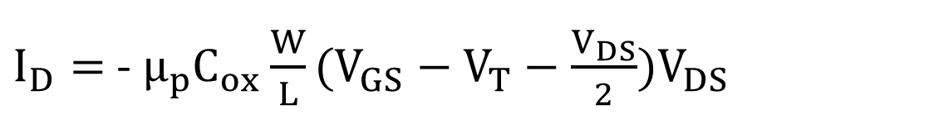
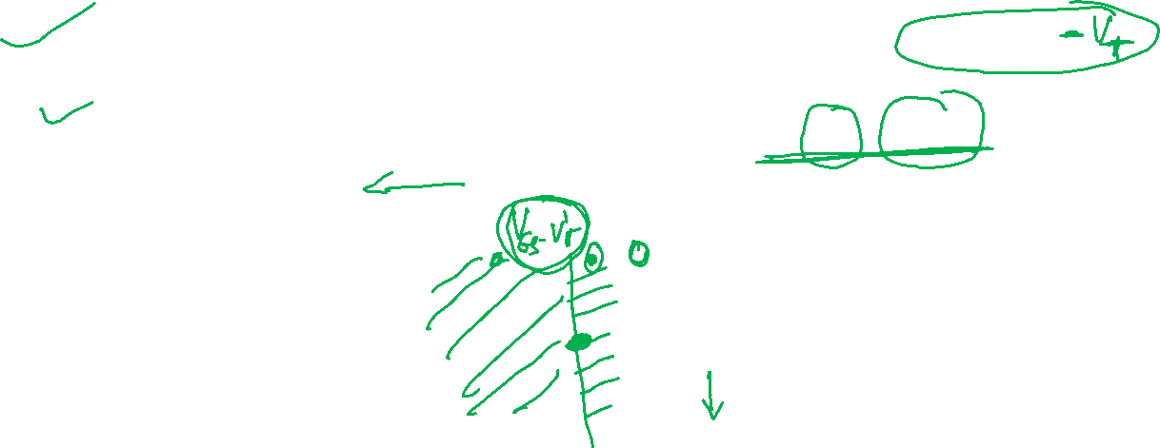
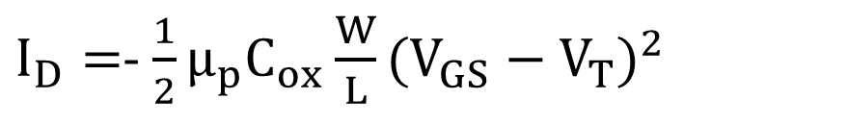
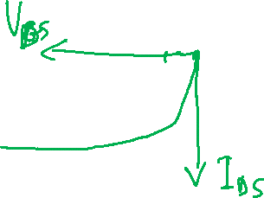
Transistor Circuit Model - MOSFET
DC analysis of MOSFET circuits requires the following relations
For p-MOS
saturation region V_{GS} <V_{T} and
V_{DS} <V_{GS}
triode (ohmic) region V_{GS}<V_{T}
and 0>V_{DS}>V_{GS}-V_{T}
cut off region V_{GS} > V_{T} , V_{DS} ≤ V_{T}
$I_{D}=$- ${\frac{1}{2}μ}_{p}C_{ox}{\frac{W}{L}(V_{GS}−V_{T})}^{2}$
$I_{D}=$ -${ μ}_{p}C_{ox}{\frac{W}{L}(V_{GS}−V_{T}−\frac{V_{DS}}{2})V_{DS}}^{}$
$$I_{D}=0$$

Slide 17
Transistor Circuit Model - MOSFET
Steps in DC analysis
Open circuit all capacitors (coupling capacitors) and short circuit all inductors if any
Calculate gate voltage (V_{G}) or gate-source voltage (V_{GS})
Based on V_{G} or V_{GS} , guess possible operating region that the transistor can be. (Saturation, triode or cut off)
Calculate DC biasing voltages and currents
Check if your assumption in (d) is valid. If valid, then the calculated DC biasing voltages and currents are correct. Otherwise, repeat steps (d-f).

Slide 18
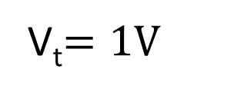
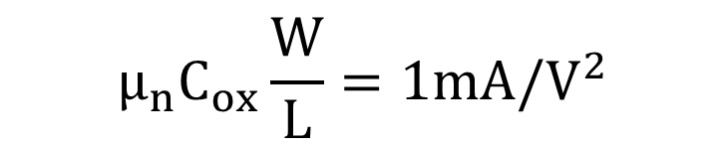
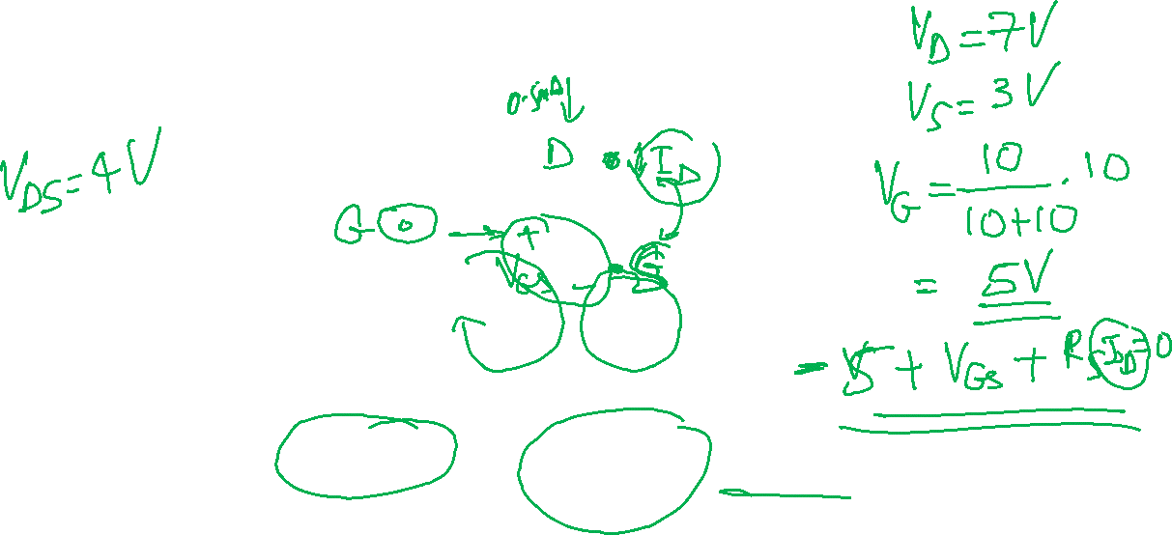
Transistor Circuit Model - MOSFET
Example:
$$μ_{n}C_{ox}\frac{W}{L}=1mA{/V}^{2}$$
Where
V_{t}$=1V$

Slide 19
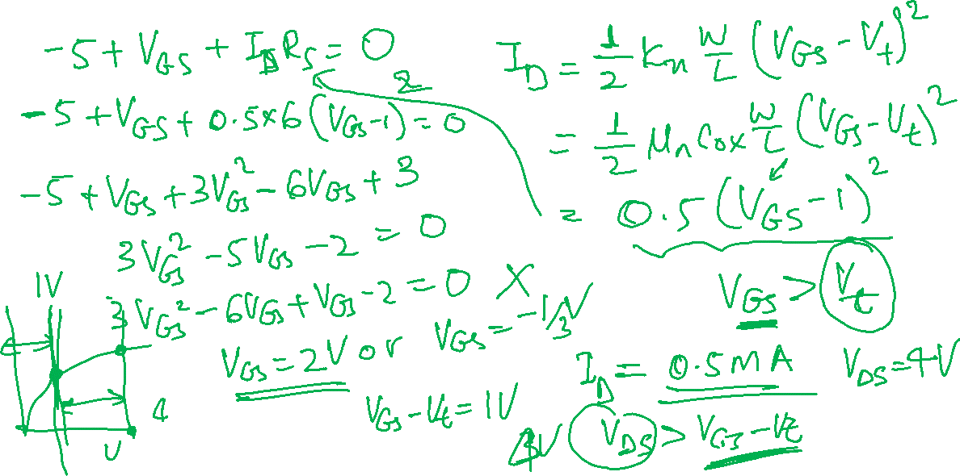
Transistor Circuit Model - MOSFET

Slide 20

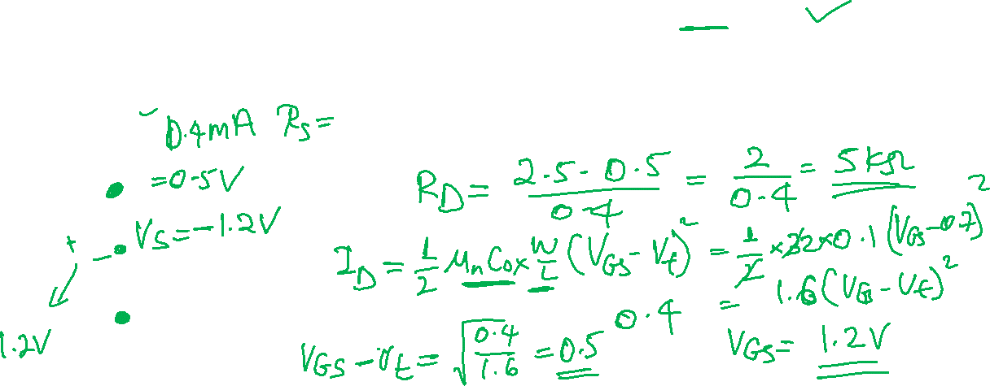
Transistor Circuit Model - MOSFET
Example 2:

Slide 21
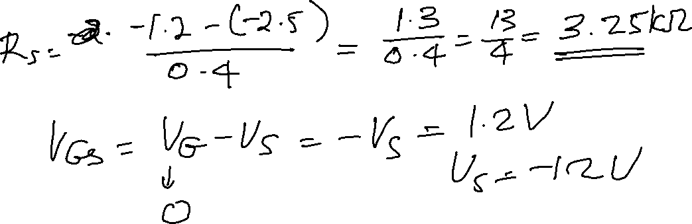
Transistor Circuit Model - MOSFET

Slide 22


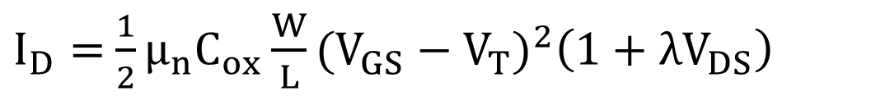
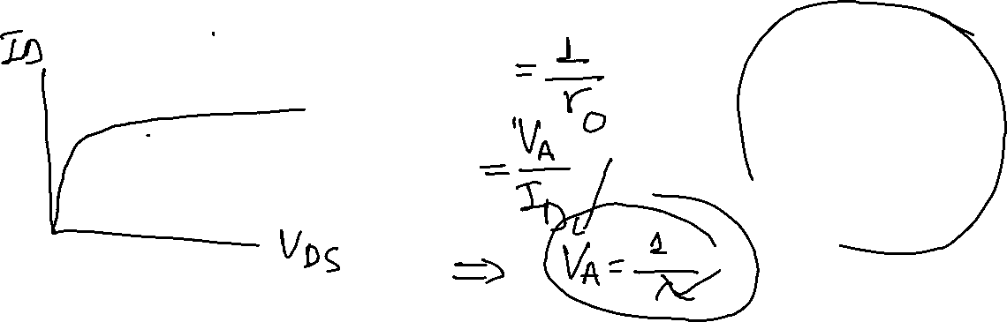
Transistor Circuit Model - MOSFET
Using enhancement mode MOSFET (with threshold voltage (V_{T}))
Since V_{G} = V_{D ,} the condition of V_{DS}> V_{GS}-V_{T} is satisfied, and therefore the MOSFET is operating in saturation region
$I_{D}=$ ${\frac{1}{2}μ}_{n}C_{ox}{\frac{W}{L}(V_{GS}−V_{T})}^{2}\left(1+λV_{DS}\right)$
$$\frac{∂I_{D}}{∂V_{DS}}=λI_{D}$$
$$r_{o}=\frac{1}{λI_{D}}$$

Slide 23







Transistor Circuit Model - MOSFET
Simple current mirror (Q1 and Q2 in saturation)
Usually, $λ$ is sufficiently small such that the I_{o}: I_{REF} is determined by the aspect ratio of W₂/L₂: W₁/L₁.This flexibility is at the disposal of the IC designer i.e. One can determine the desired current ratio by choosing the transistor sizes.
Again, the output resistance is given by:
$V_{GS1}=$ $V_{GS2}$
$I_{REF}=$ ${\frac{1}{2}μ}_{n}C_{ox}{\frac{W1}{L1}(V_{GS1}−V_{T})}^{2}\left(1+λ1V_{DS1}\right)$
$I_{0}=$ ${\frac{1}{2}μ}_{n}C_{ox}{\frac{W2}{L2}(V_{GS2}−V_{T})}^{2}\left(1+λ2V_{DS2}\right)$
$$\frac{ \left(1+λV_{DS2}\right)\frac{W2}{L2}}{ \left(1+λV_{DS1}\right)\frac{W1}{L1}}=\frac{I_{o}}{I_{REF}}$$
$$r_{o}=\frac{1}{λI_{o}}$$

Slide 24








Transistor Circuit Model - MOSFET

Slide 25

Transistor Circuit Model - MOSFET

Slide 26
Transistor Circuit Model - MOSFET

